Slide 1

SQL – Project
* Ruchi Gohil

Slide 2
TABLE OF CONTENTS
01.
02.
03.
04.
Company’s information
Data points
DDL
Tables snapshot

Slide 3

Why apply to jobs on shortlist?

Slide 4
What’s the company all about?
Shortlist is a recruiting technology company that helps employers in Africa and India build and develop world-class teams.
The Shortlist platform screens candidates using predictive chat-based interviews and online competency-based assessments.
Which helps each employer to efficiently and objectively identify top talent for junior- to mid-level roles

Slide 5
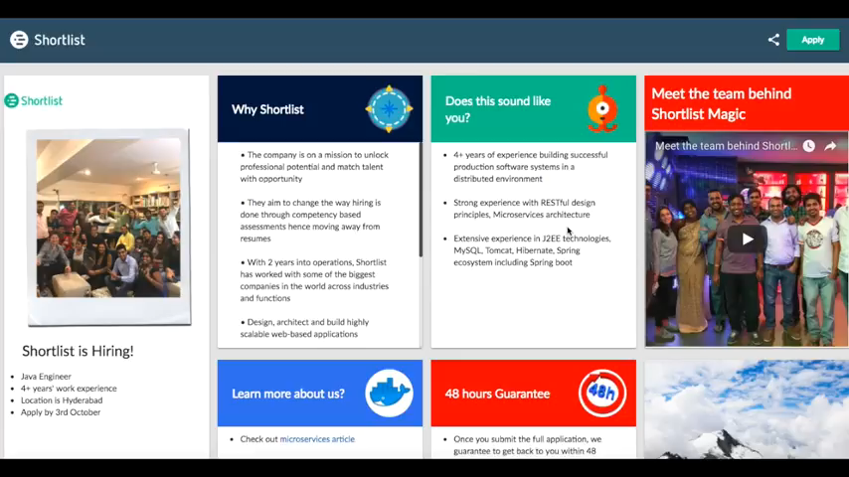
Chat Bots for Assessment

Slide 6
DATA Points
Candidates Information
Candidates Invoice
Employee
Employer
Score
Invoice
Question Bank for Candidate Assessment
Question Bank for Personality Questions
Login
Job Builder
Application
Candidate Management Platform
Candidates Skills
Candidates Assessment
Candidates Personality Quality

Slide 7
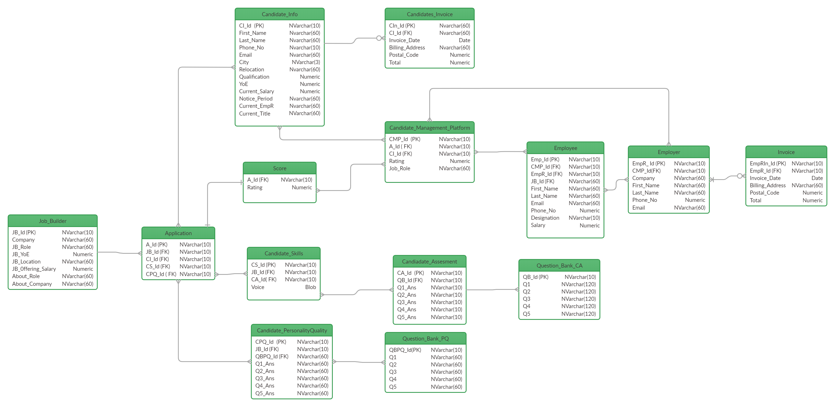

Slide 8
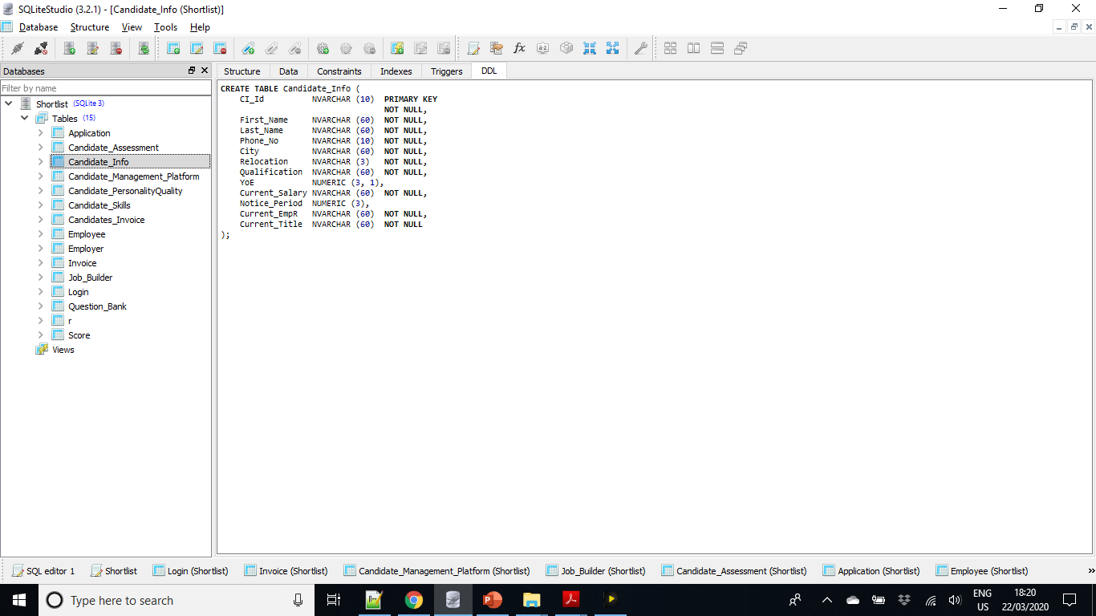
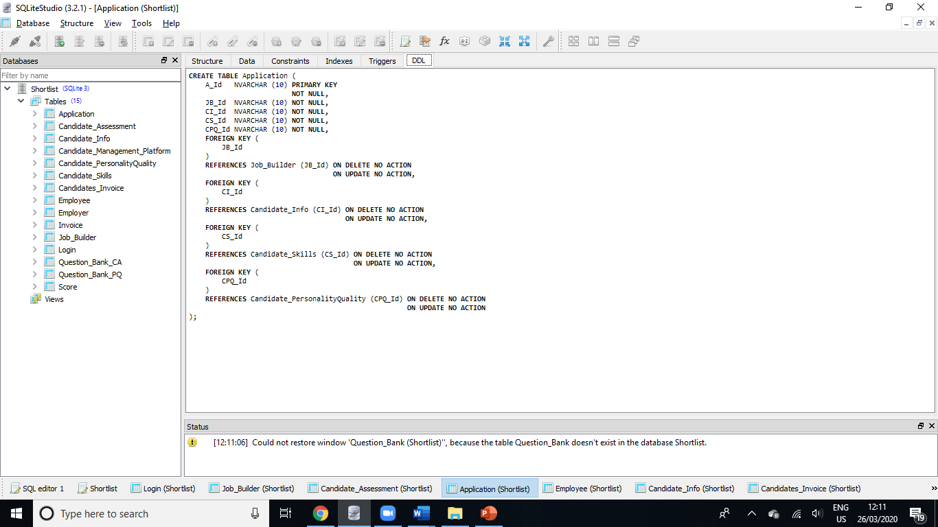
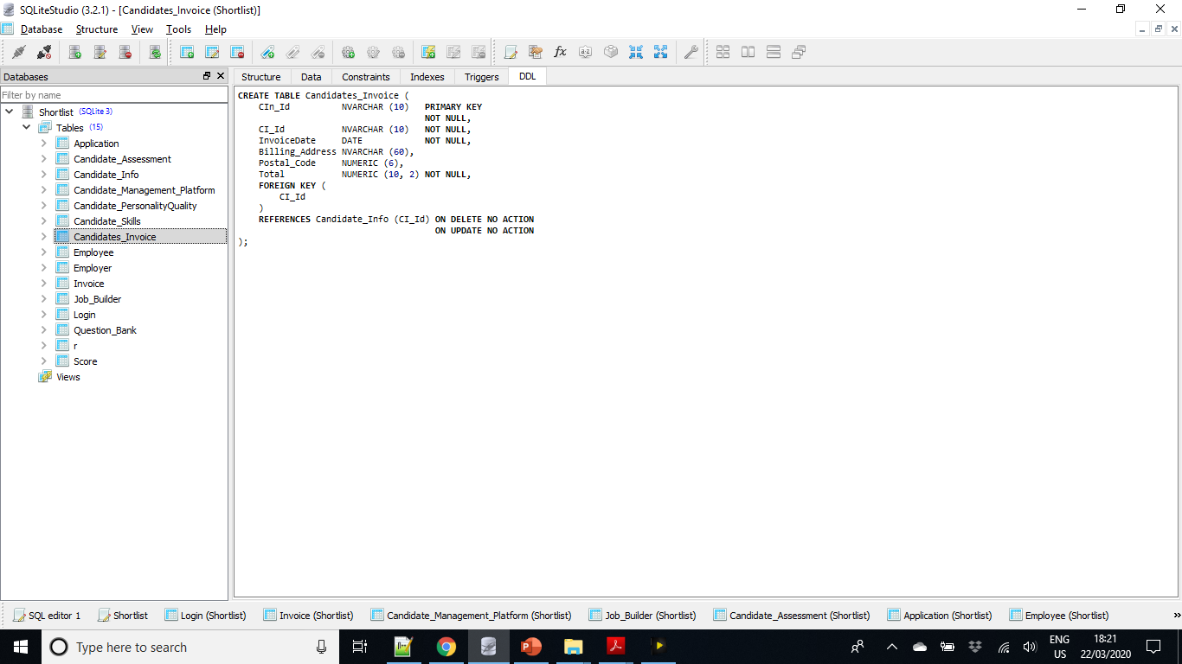
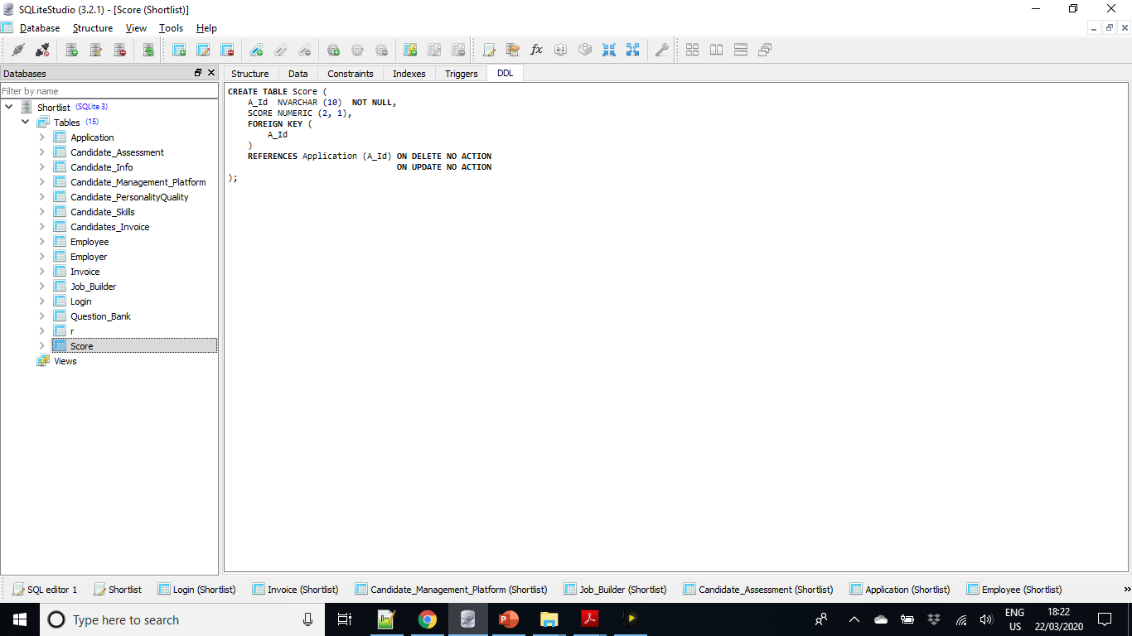
DDL
Weak Entity

Slide 9
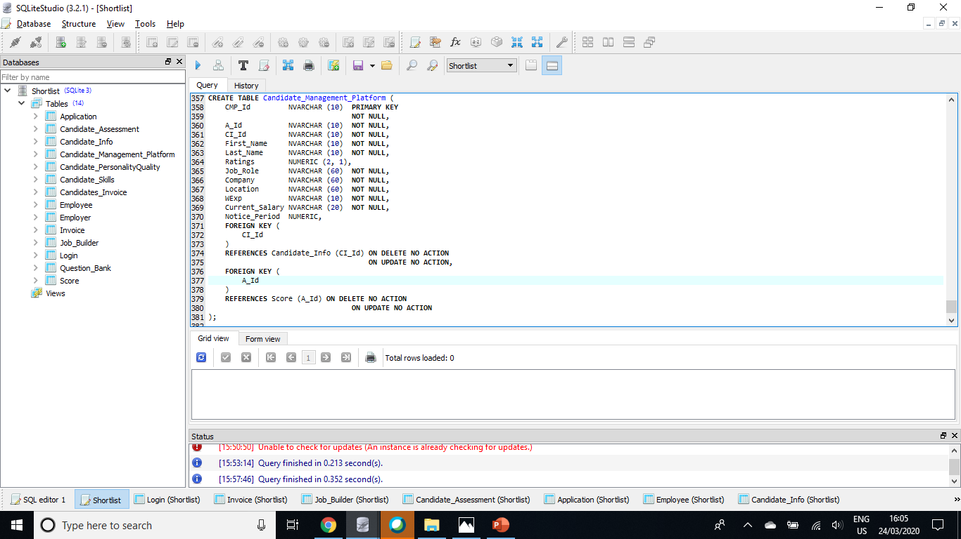
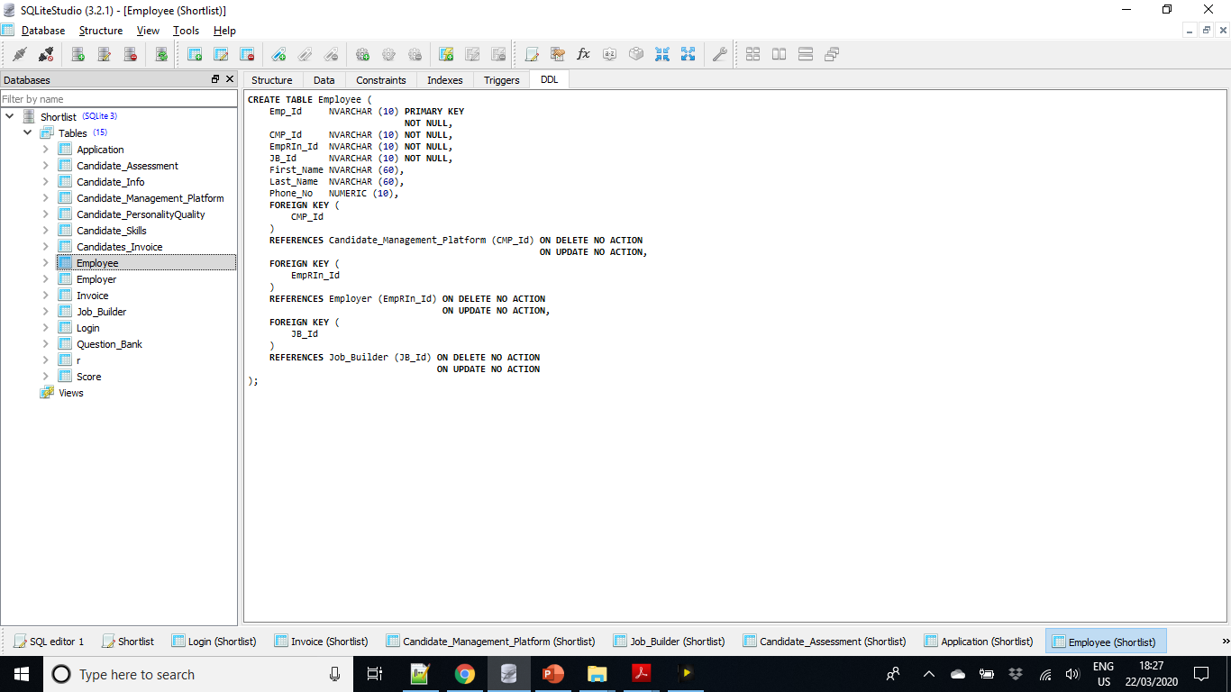
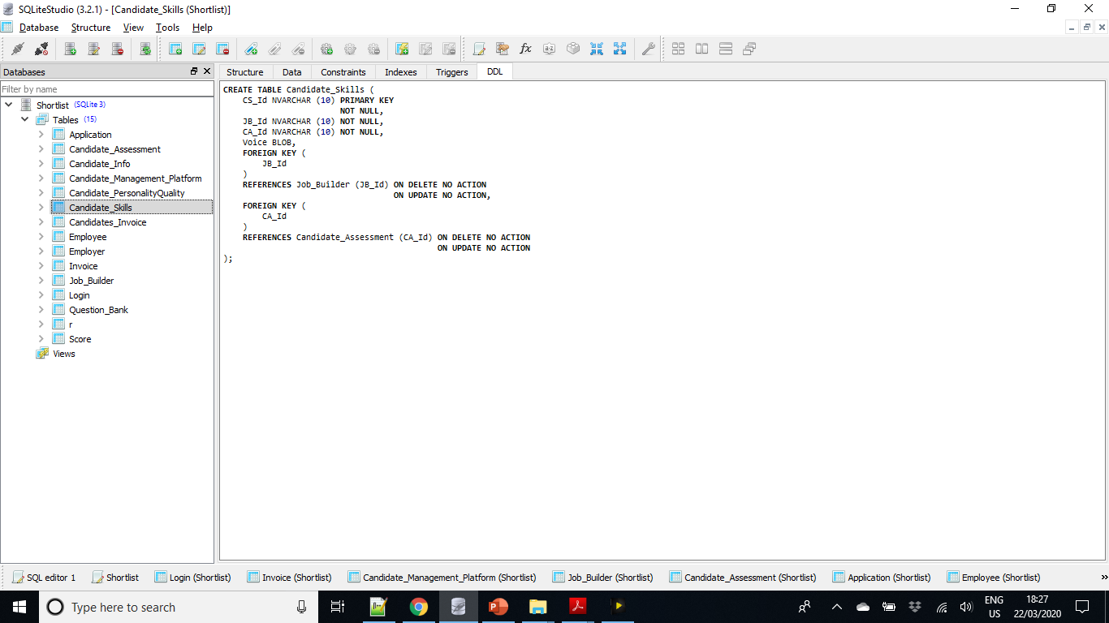

Slide 10
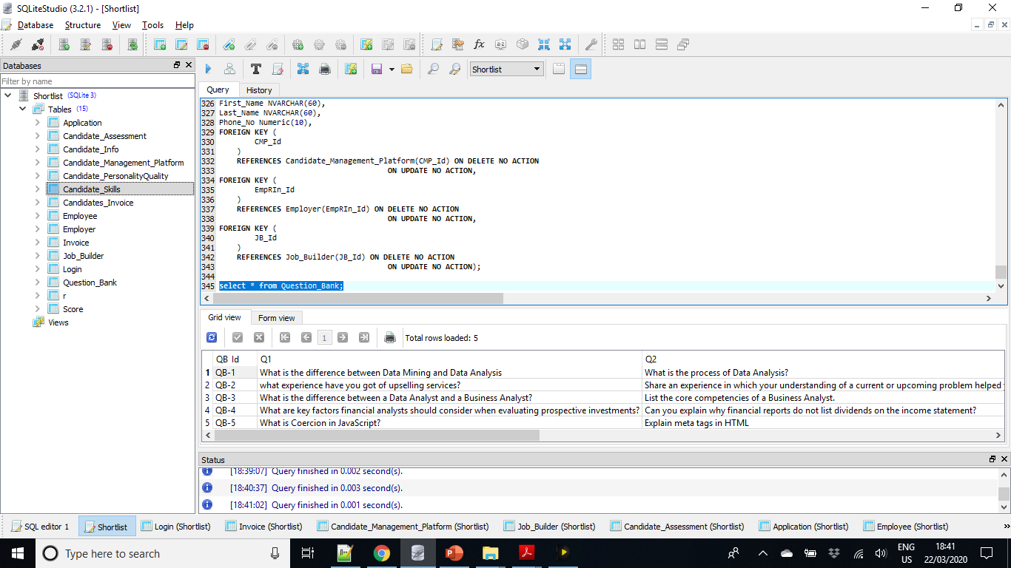
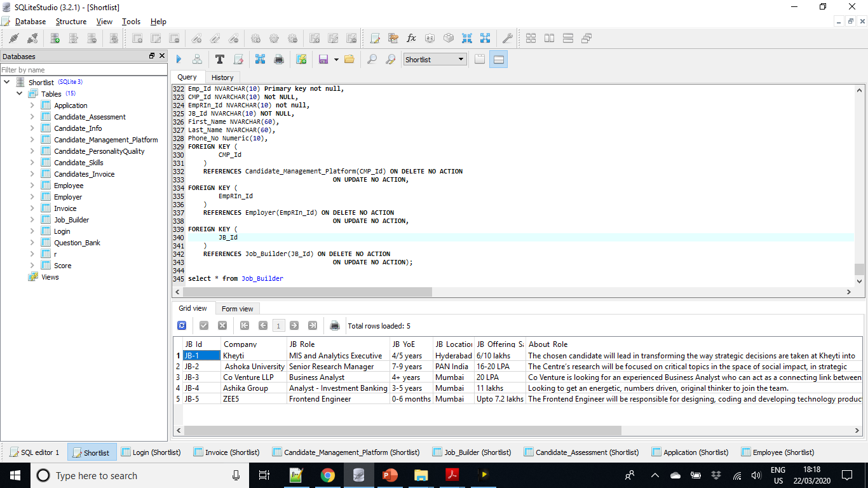
Tables Snapshots

Slide 11
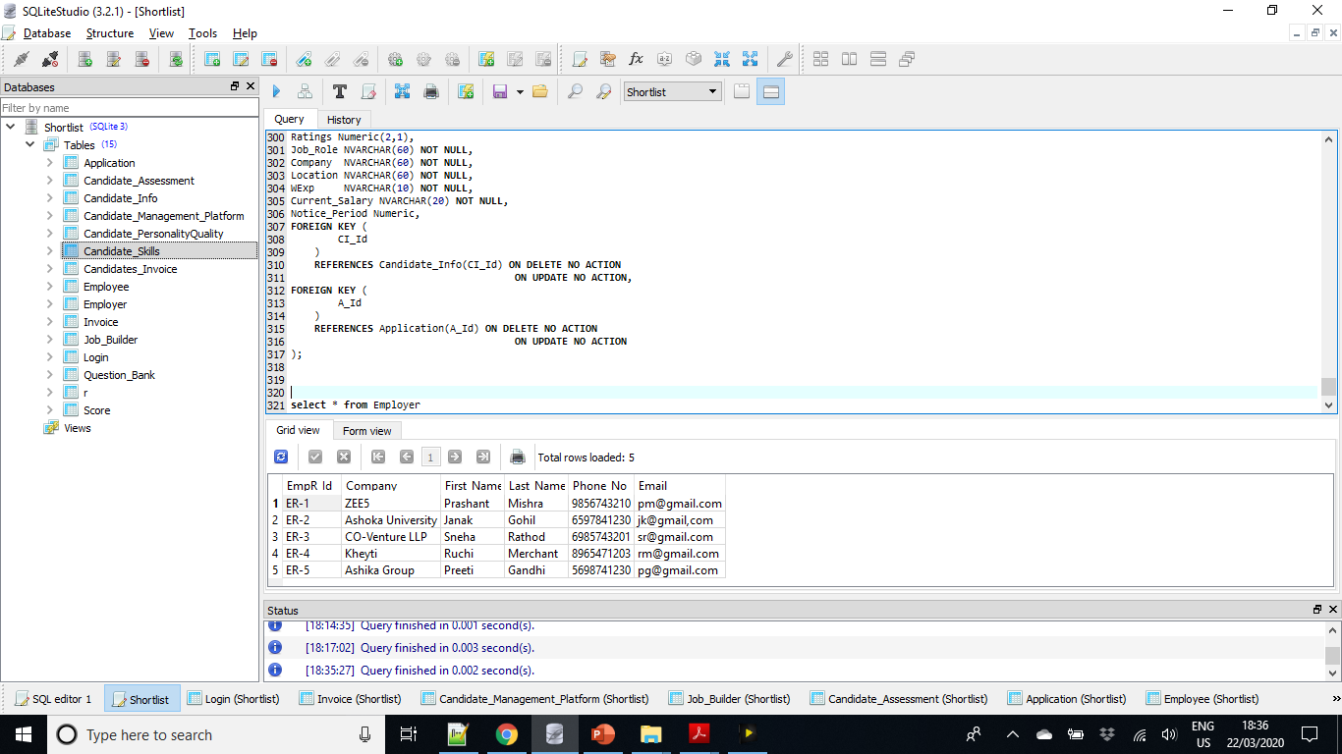

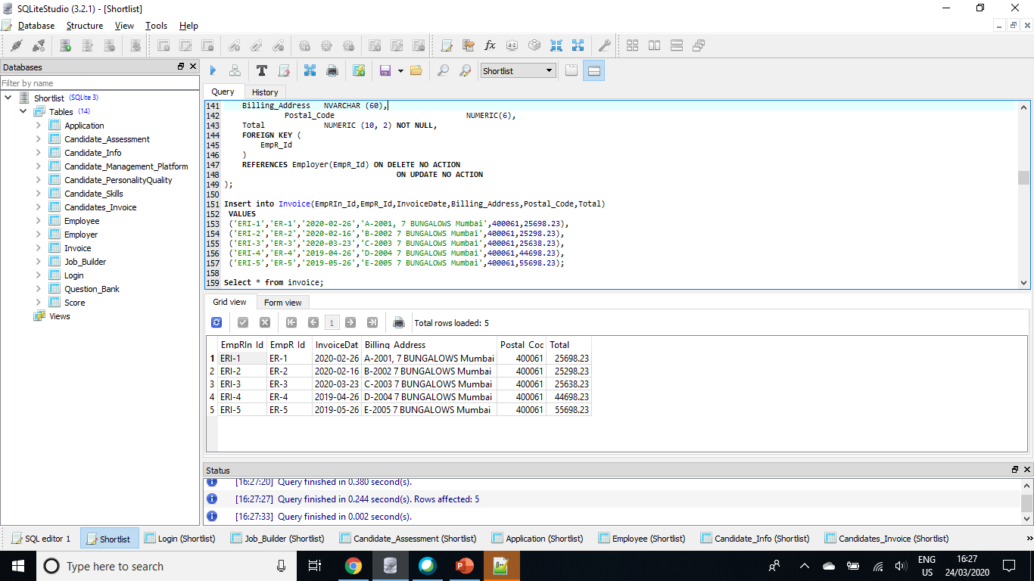

Slide 12

THANKS!

